Slide 1
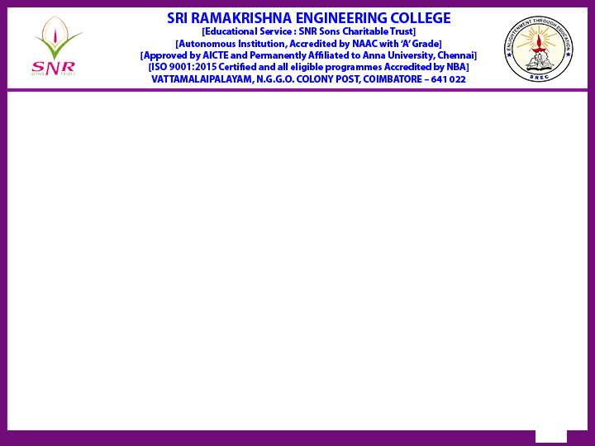
Reaccredited by NAAC with A+ grade]
Batch No:23
20ME278 – Mini Project II
“AI-Enhanced Medical Chatbot: Optimizing Doctor Schedules and Patient Services”
Type of Project: Real Time Implementation
Presented by
Adharsha V – 71812201007 (CSE)
Dhivyashree MP– 71812201042 (CSE)
Shree Nithi VM – 718125301024 (Mtech)
Guided by
Dr.R.Anuradha.,Prof/CSE
Review Type :0th Review
Date : 06.09.2024

Slide 2
Contents
S.No | Description | Slide Number
1 | Introduction | 3
2 | Problem Definition | 4
3 | Modules of the project | 5-6
4 | Initial Implementation and Workflow | 7
5 | Timeline | 8
6 | References | 10

Slide 3
Introduction
Modern healthcare faces challenges in managing doctor workloads and ensuring quality patient care.
Our project proposes an AI-powered chatbot that integrates natural language processing (NLP) and voice recognition to automate appointment management, inventory control, and patient interactions.
The chatbot aims to reduce the administrative burden on doctors and improve patient engagement by providing timely, personalized information.

Slide 4
Problem Definition
Current Challenges:
Overbooked schedules and high workloads for doctors.Manual processes for managing appointments and inventory.
Lack of personalized and timely patient engagement.
Need for Improvement:
Streamlined appointment scheduling and management.
Automated inventory tracking and alerts.
Enhanced communication between patients and healthcare providers.

Slide 5
Modules of the Project
Appointment Management:
Automatically schedules, reschedules, and cancels appointments based on the doctor’s availability and workload.
Recommendation System:
AI-driven module that suggests optimal appointment times to reduce doctor fatigue.
Inventory Management:
Monitors stock levels, provides alerts for low stock, and generates inventory reports.

Slide 6
Modules of the Project
Voice Recognition & NLP:
Allows doctors to interact with the chatbot using voice commands, making it faster and easier to use.
Patient Engagement:
Provides accurate responses to patient queries, symptom analysis, and health advice.
Integration with Website:
Seamless interface for doctors and patients to access chatbot functionalities.

Slide 7
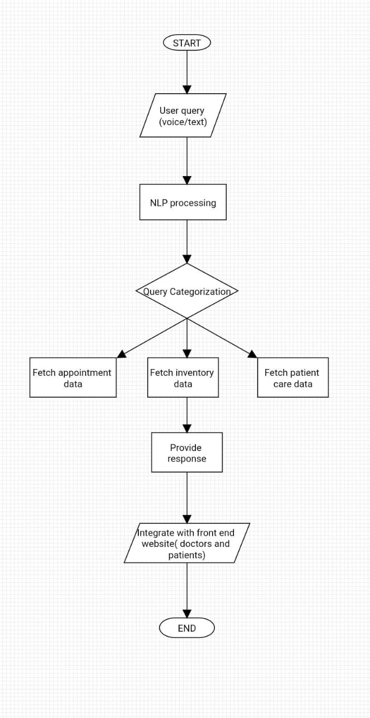
WorkFlow

Slide 8
Timeline of the Project and Budget
Month 1-2: Requirement analysis, technology stack selection, chatbot framework design.
Month 3-4: Develop core functionalities,appointment management, voice recognition, and patient engagement.
Month 5: Implement recommendation system and integrate inventory management.
Month 6: Testing, debugging, and performance optimization.
Month 7: Website integration and UI enhancements; deployment.
Month 8: Collect user feedback, make improvements, and finalize documentation.

Slide 9
Benefits and Innovation
Efficiency:
Reduces time spent on administrative tasks, allowing doctors to focus more on patient care.
Accuracy:
AI models ensure precise responses to medical queries and optimized scheduling.
Engagement:
Enhanced patient interaction through personalized responses and health reminders.
Scalability:
Easily integrates with existing healthcare systems and websites.

Slide 10
References
1.Cao, Y., Zhou, M., & Wang, J. (2024). Network-integrated medical chatbot for enhanced healthcare services. Journal of Healthcare Informatics Research Paper.
2.Xiwei Wang, Ran Luo, Yutong Liu, Peng Chen, Yuanyuan Tao, Yuming He,
Revealing the complexity of users’ intention to adopt healthcare chatbots: A mixed-method analysis of antecedent condition configurations,
Information Processing & Management,Paper Link
3.Loukas Triantafyllopoulos, Georgios Feretzakis, Lazaros Tzelves, Aikaterini Sakagianni, Vassilios S. Verykios, Dimitris Kalles,
Evaluating the interactions of Medical Doctors with chatbots based on large language models: Insights from a nationwide study in the Greek healthcare sector using ChatGPT, Paper Link

